Slide 1
«РОЗРОБКА АЛГОРИТМУ НАВЧАННЯ ТОЧКОВОЇ МОДЕЛІ РАНЖУВАННЯ СПИСКУ, ЗАЛЕЖНОЇ ВІД ЙОГО КОНТЕКСТУ»
ДНІПРОВСЬКИЙ НАЦІОНАЛЬНИЙ УНІВЕРСИТЕТ
ІМЕНІ ОЛЕСЯ ГОНЧАРА
Факультет прикладної математики
Кафедра обчислювальної математики та математичної кібернетики
Кваліфікаційна робота
перший (бакалаврський) рівень вищої освіти спеціальність 124 Системний аналіз
Виконавець
студент групи ПС–18–1
Каманцев Артем Сергійович
Керівник
Доцент кафедри ОМ та МК О.М. Притоманова
Дніпро 2022

Slide 2
Structured information extraction
Unstructured information
Structured information
Information retrieval
Image recognition
Image
Video
Entities
and their relations
NLP
Text
Audio

Slide 3
Natural Language Processing (NLP) tasks
Natural Language Processing
(NLP)
Named Entity Recognition
(NER)
Relation Extraction
(RE)
Event Extraction
(EE)

Slide 4
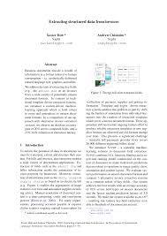
NER task example
Sign date: “1.01.2022”
Amount: ”1 000 000$”
Governing law: “This Agreement is accepted by the Parties in the State of Nevada and shall be governed by and construed in accordance with the laws thereof, which laws shall prevail in the event of any conflict.”
Unstructured information
Structured information

Slide 5
NER system types
Rule-Based
(RBM)
Hybrid
Learning-Based
(LBM)

Slide 6
Example of NER hybrid system
Find entity-candidates in text (RBM):
Dates: 1.01.2022, 1/01/2022,…
Numbers: 1, 2, 1st, 2nd , one hundred…
Currencies: 5$, 5 USD, 5 €,…
Sentences: “This agreement is governed by…”,…
Train some model on labeled data. Use it to find entities among entity-candidates (LBM)
Simplification: find the entity-candidate most likely to be the entity.
Find entity-candidates
Rank the list of entity-candidates
(criterion: likelihood to be the entity)
Return the first item of ranked list

Slide 7
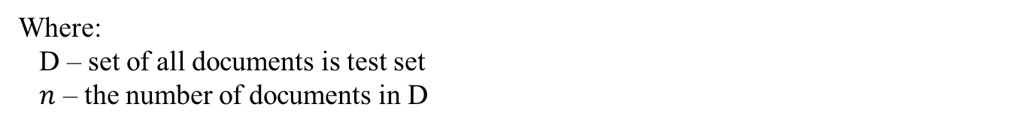
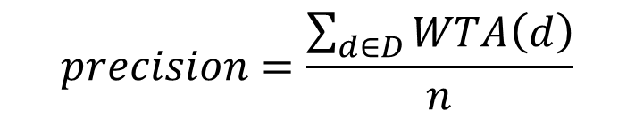
Ranking problem
Ranking problem statement:
By given query $Q$ (criterion) order the list of items $I$
In terms of hybrid NER system:
Q – fixed, equals to: “Likelihood to be the entity”
I – list of entity-candidates
Scoring metrics – Winner-Takes-All
$$WTA(d)=\left\{\begin{aligned}&1, the first candidated in ranked list IS an entity \\ &0, the first candidate in ranked list IS NOT an entity\end{aligned}, d∈D\right.$$
$$precision=\frac{\sum_{d∈D}{WTA\left(d\right)}}{n}$$
Where:
D – set of all documents is test set
$n$ – the number of documents in D

Slide 8
Ranking problem. Approaches
Ranking
Pointwise
Pairwise
Listwise

Slide 9
Learning to rank. Classic pointwise approach
Candidate 1
Classification model
p 1
…
…
…
Raw text
Find candidates
Candidate i
Classification model
p i
Select
the most probable one
…
…
…
Candidate m
Classification model
p m

Slide 10
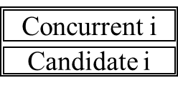
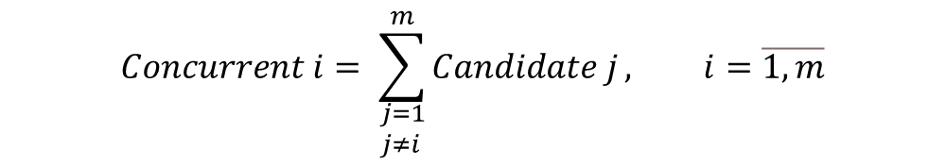
Learning to rank. Proposed pointwise approach
Concurrent 1
Classification model
p 1
Candidate 1
…
…
…
Raw text
Find candidates
Concurrent i
Classification model
p i
Select
the most probable one
Candidate i
…
…
…
Concurrent m
Classification model
p m
Candidate m
Where:
$$Concurrent i= \sum_{\begin{aligned}&j=1 \\ &j≠i\end{aligned}}^{m}{Candidate j}, i=\overline{1,m}$$
- $Concurrent i$ and $Candidate i$ vectors concatenation, $i=\overline{1,m}$

Slide 11
Goal. Topicality
The goal of this research is to evaluate answer for the question: “Whether the information about competitors improves the quality of ranking or not?”
Text information structuring allows to automate business processes and increase of quality of such structuring is topical task.

Slide 12
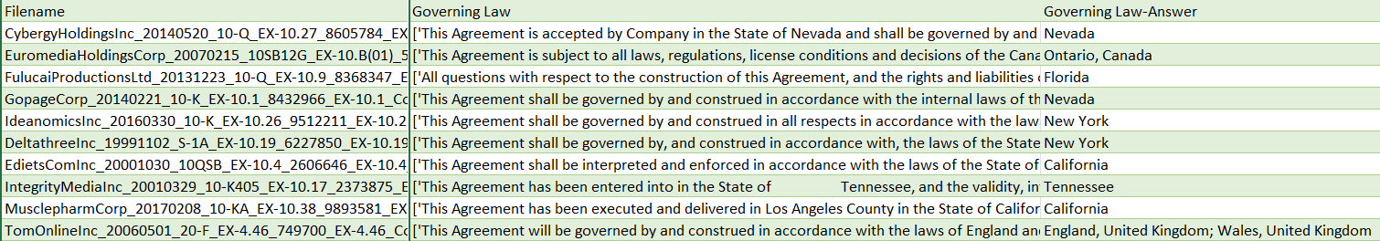
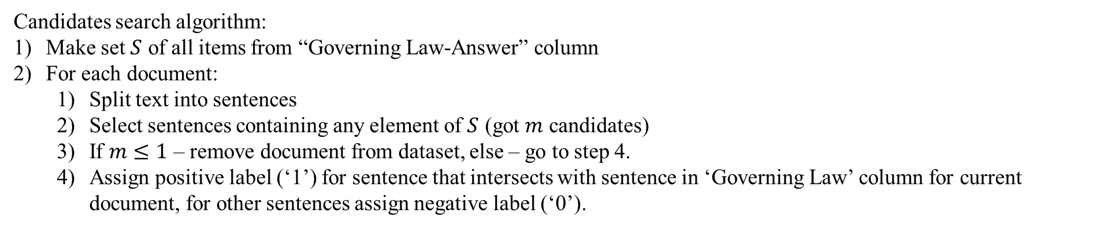
Dataset CUAD V1
CUAD V1 – open-source dataset of commercial legal contracts. Consists of:
PDF documents
Txt files with text extracted from this PDFs
Labels for each document
Labels example:
Candidates search algorithm:
Make set $S$ of all items from “Governing Law-Answer” column
For each document:
Split text into sentences
Select sentences containing any element of $S$ (got $m$ candidates)
If $m≤1$ – remove document from dataset, else – go to step 4.
Assign positive label (‘1’) for sentence that intersects with sentence in ‘Governing Law’ column for current document, for other sentences assign negative label (‘0’).
Items in dataset after cleaning: 419

Slide 13
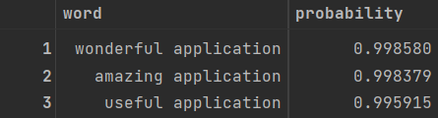
Dataset of Google Play Reviews
Data item example:
Main task: detect most positive word in each comment.
Sub task: measure “positiveness” of each word.
Sub task solution steps:
Vectorize text by Bag-of-words technique.
Train binary classifier for positive/negative comments detection (Naïve Bayes).
Use trained models’ coefficients to sort words by their “positiveness”.
Candidates – words from comment text.
Positive label assigned to the word in comment with highest “positiveness” rate.
Items in dataset after cleaning: 25000

Slide 14
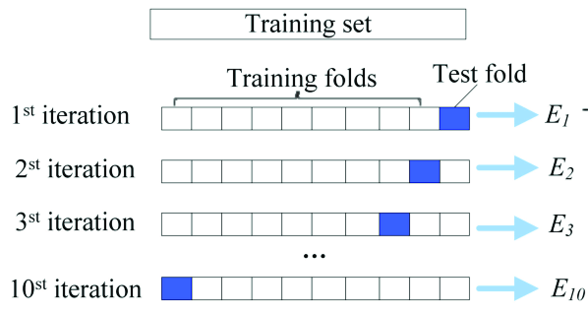
Training and testing
K-fold cross-validation:
Google Play Reviews – 4-fold cross-validation
CUAD V1 – 7 repeats of 10-fold cross-validation

Slide 15
Classification models
MultinomialNB (scikit-learn library).
LogisticRegression (scikit-learn library).
KNeighborsClassifier (scikit-learn library).
SVC scikit-learn.
DecisionTreeClassifier (scikit-learn library).
XGBClassifier (xgboost library).

Slide 16
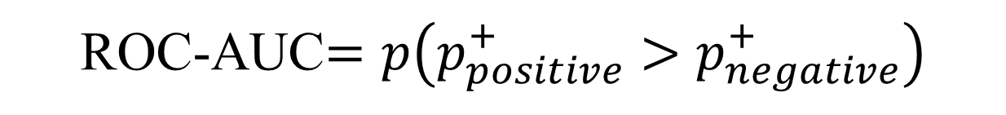
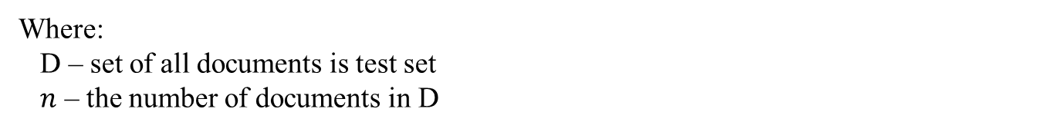
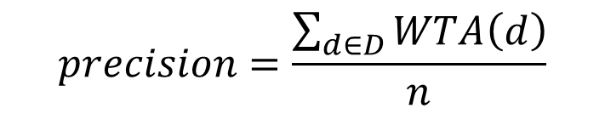
Metrices
$$WTA(d)=\left\{\begin{aligned}&1, the first candidated in ranked list IS an entity \\ &0, the first candidate in ranked list IS NOT an entity\end{aligned}, d∈D\right.$$
$$precision=\frac{\sum_{d∈D}{WTA\left(d\right)}}{n}$$
Where:
D – set of all documents is test set
$n$ – the number of documents in D
ROC-AUC$=p\left(p_{positive}^{+}>p_{negative}^{+}\right)$

Slide 17
Evaluation of results
Mann-Whitney U test
Nonparametric test, often used to test mean difference in two samples

Slide 18
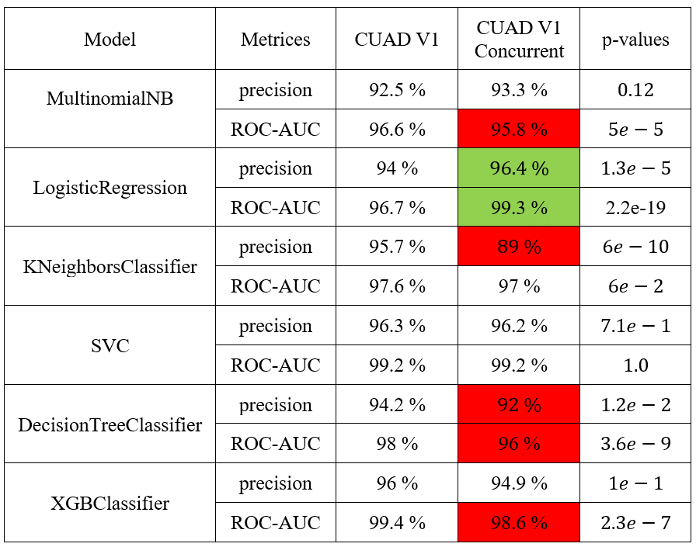
Experiment results. CUAD V1

Slide 19
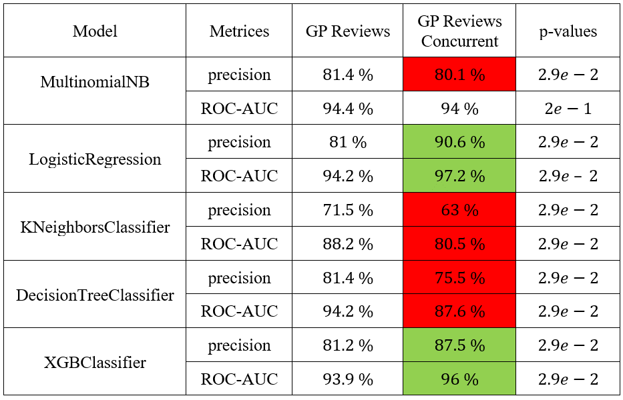
Experiment results. Google Play Reviews

Slide 20
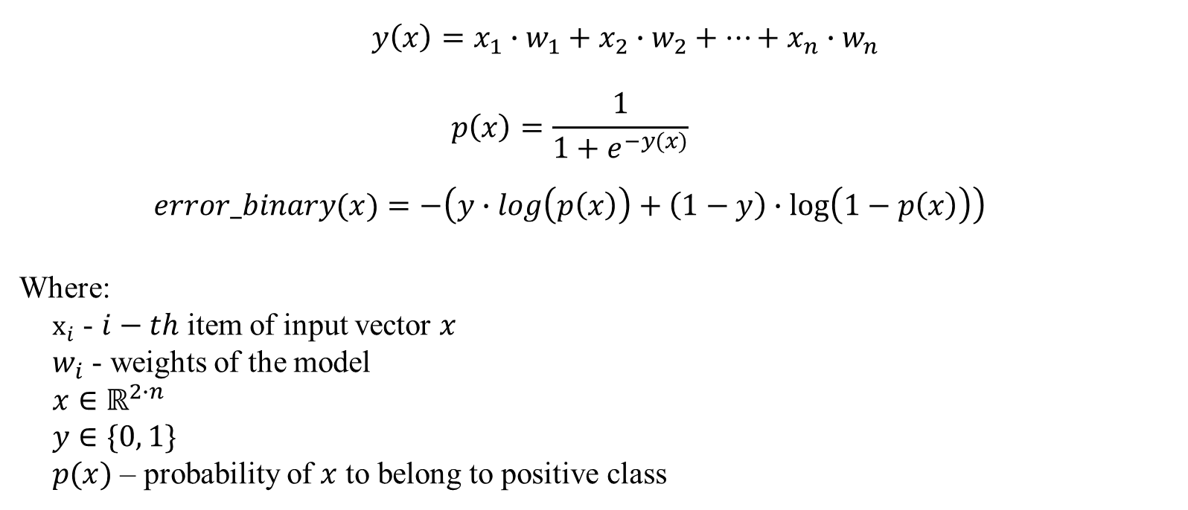
Logistic Regression
$y\left(x\right)=x_{1}∙w_{1}+x_{2}∙w_{2}+…+x_{n}∙w_{n}$
$$p\left(x\right)=\frac{1}{1+e^{−y(x)}}$$
$$error_binary(x)=−\left(y∙log\left(p\left(x\right)\right)+\left(1−y\right)∙\log\left(1−p\left(x\right)\right)\right)$$
Where:
$x_{i}$ - $i−th$ item of input vector $x$
$w_{i}$ - weights of the model
$$x∈ℝ^{2∙n}$$
$$y∈\{0, 1\}$$
$p(x)$ – probability of $x$ to belong to positive class

Slide 21
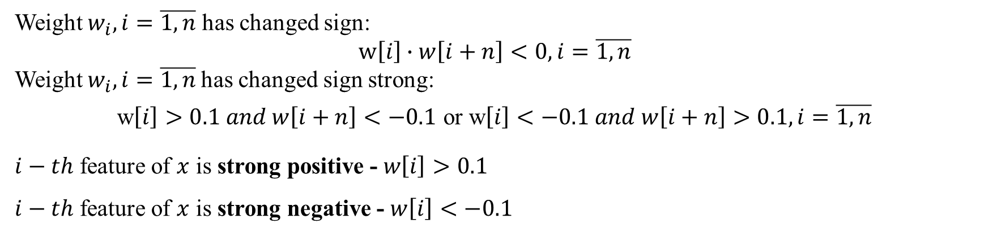
Logistic Regression. Weights analysis
w $∈ℝ^{2∙n}$ - weights of logistic regression
Weight $w_{i}, i=\overline{1,n}$ has changed sign:
$$w\left[i\right]∙w\left[i+n\right]<0, i=\overline{1,n}$$
Weight $w_{i}, i=\overline{1,n}$has changed sign strong:
w$\left[i\right]>0.1 and w\left[i+n\right]<−0.1$ or w$\left[i\right]<−0.1 and w\left[i+n\right]>0.1, i=\overline{1,n}$
$i−th$ feature of $x$ is strong positive - $w\left[i\right]>0.1$
$i−th$ feature of $x$ is strong negative - $w\left[i\right]<−0.1$
 | CUAD V1 |  | Google Play Reviews
 | Changed sign | Changed sign strong | Changed sign | Changed sign strong
Strong positive weights | 95% | 76% | 85% | 80%
Strong negative weights | 92% | 52% | 50% | 32%

Slide 22
Results analysis
Observations:
Concurrent approach has improved results only for Logistic Regression and for XGBClassifier on Google Play Reviews dataset.
Higher percent of strong positive coefficients have changes sign and have changed sight strong compared to strong negative weights. This shows intuitive pattern:
Any of competitors has strong positive feature -> current candidate is not an entity
Any of competitors has strong negative feature -> current candidate may not be an entity
Many of competitors have strong negative features -> current candidate is an entity
Possible reasons of other models' failures:
Curse of dimensionality (number of features increased by 2 times, number of items hasn’t changed)
Complexity of additional information and model architecture peculiarities.

Slide 23
Conclusion
A new approach to data creation for pointwise ranking model was proposed and tested.
Proposed approach gives some useful information to the model
New information cold have too complex structure to learn for some models
It increases data dimensionality a lot
The further research is required to certainly determine fail reasons of tested models and evaluate an effectiveness of proposed approach in general case.
The possible directions of further researches:
Apply dimension reduction.
Make number of items in training sample created for proposed approach greater compared with classic pointwise approach.
Test most popular architectures of neural networks: FCNN, CNN, RNN, Fully Convolutional Neural Network.
Compare proposed approach with pairwise and listwise ranking models.
Evaluate effectiveness of proposed approach with metrices different from WTA.
Evaluate effectiveness of proposed approach with different datasets.

Slide 24
Thank you for attention!

Slide 25
Vector data representation
Each (of 2) dataset has the structure, like the following:
[
([[0, 0, 1],
[1, 0, 0]], [0, 1]),
([[1, 0, 1],
[0, 1, 0],
[0, 1, 1]], [0, 1, 1]),
...
]

